Slide 1
A machine learning approach to House
Price Indexes with the `hpiR` package
Andy Krause – Zillow Group Home Valuations
American Real Estate Society 2019 Meeting

Slide 2
Outline
‘hpiR’ package and data
Conceptual Model + Motivation
A Random Forest House Price Index
Performance Comparison
Discussion

Slide 3
‘hpiR’ package
R package for house price indexes :https://cran.r-project.org/web/packages/hpiR/index.html
Methods for generating ‘coefficients’ and converting to index
Hedonic + Repeat Sales
Random Forests (Github/development version only)
Methods for index validation and comparison
Accuracy
Revision
Volatility
Generic Functionality
Smoothing
Imputation
Series Creation
Data Set
Seattle home sales from 2010 through 2016 (43k, 5k repeat)
Rich hedonic characteristics

Slide 4
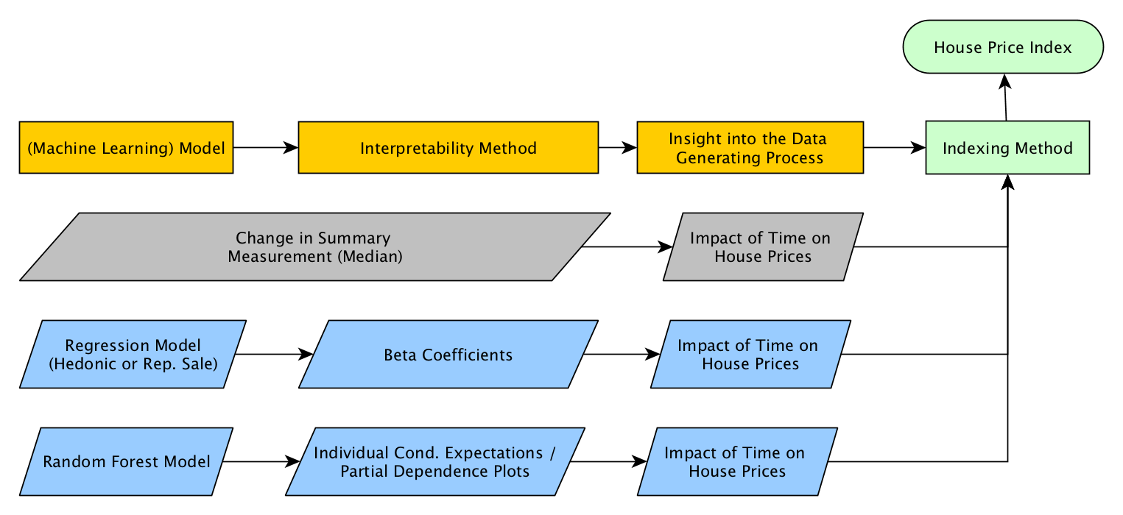
Conceptual Model + Motivation

Slide 5
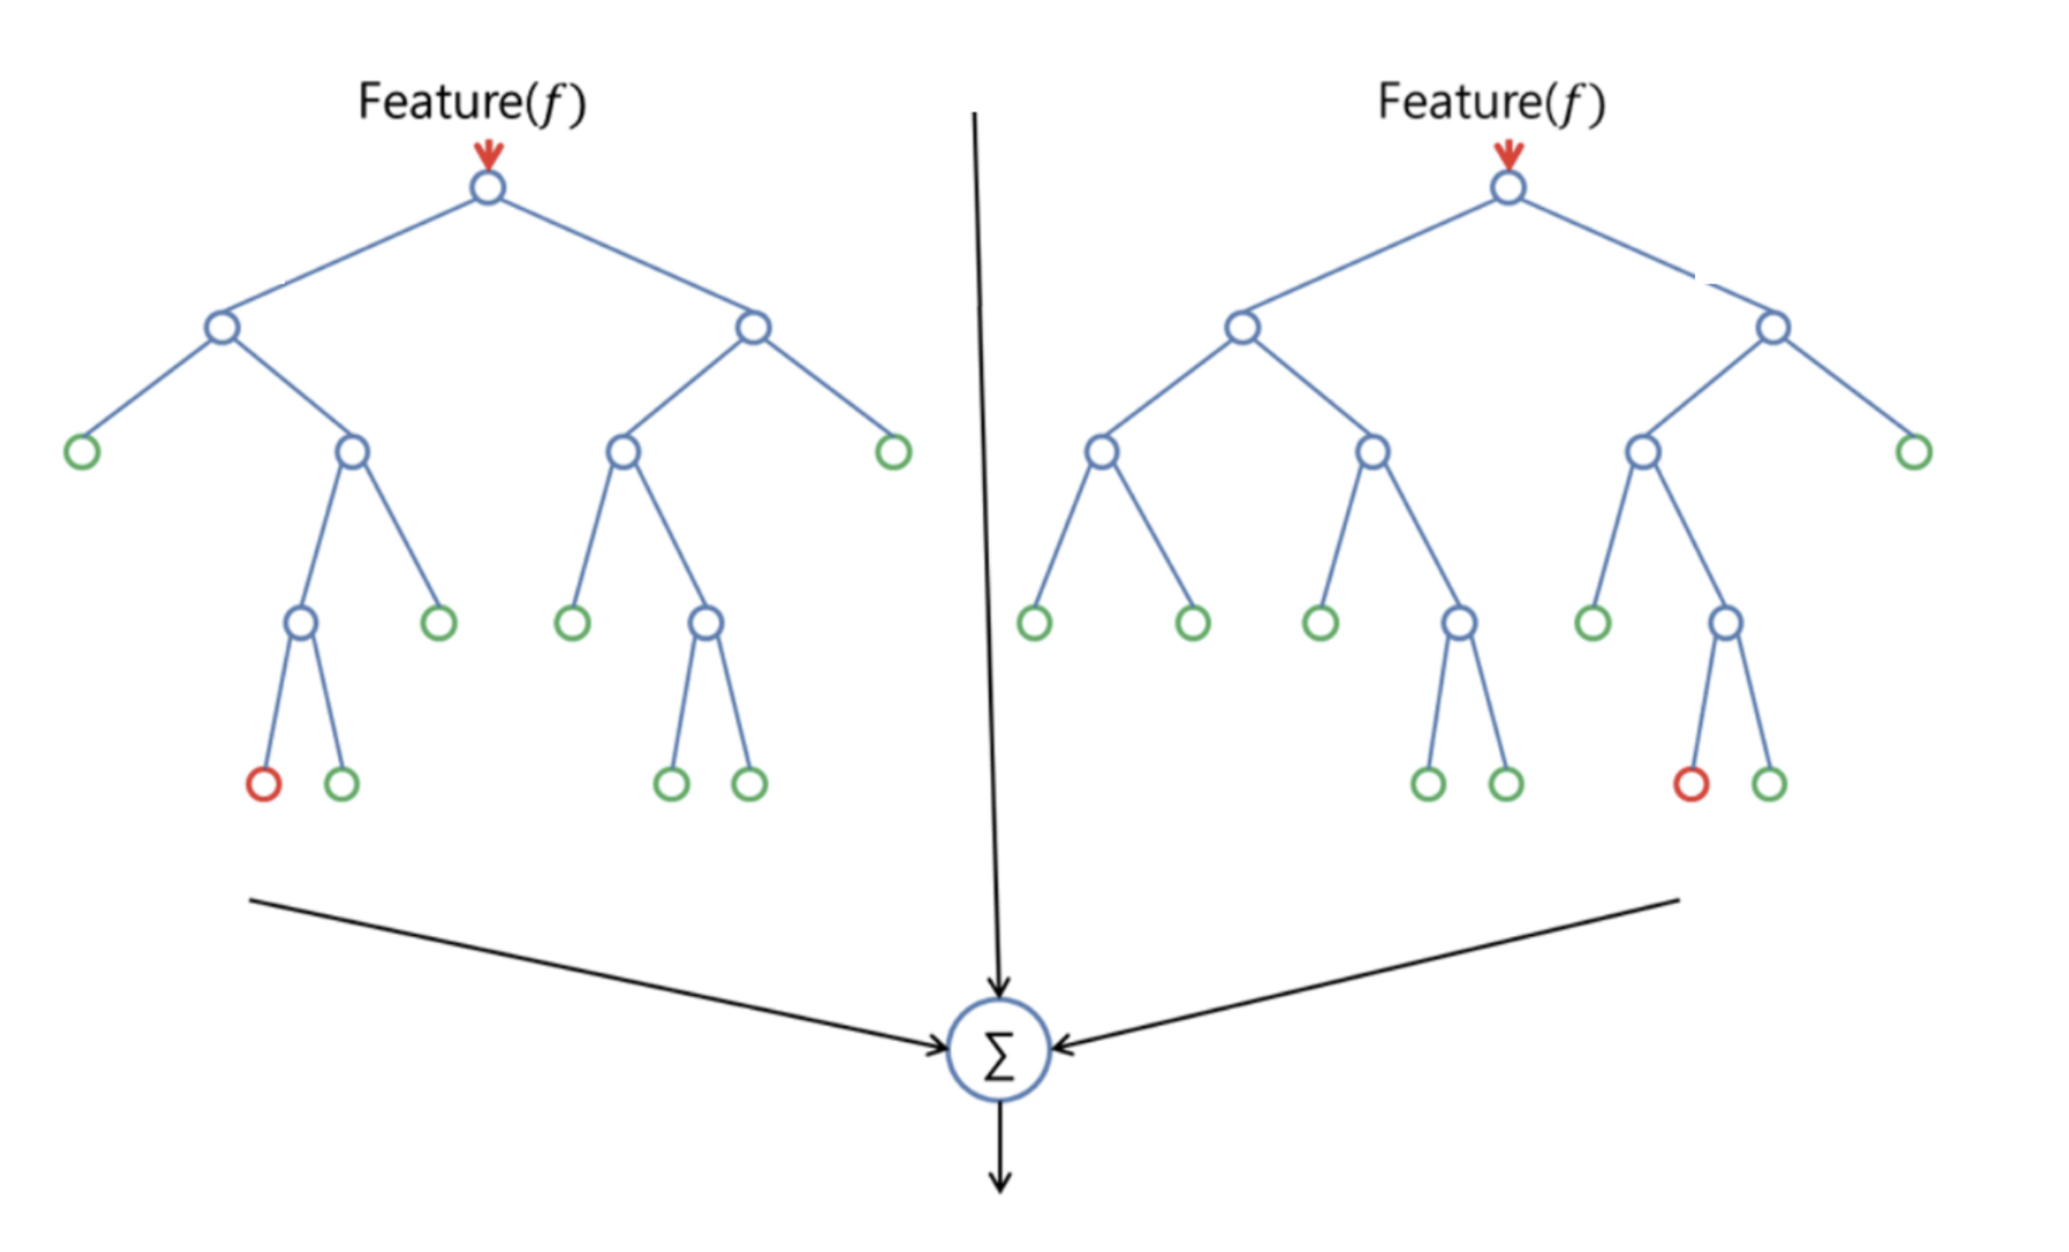
What is a Random Forest?
Subsetting process
Multiple decision trees trained on randomized sub-samples of data/features
Each split in tree is a single feature (e.g. Is Waterfront. Yes (left) / No (right)
Prediction is (weighted) result of each tree

Slide 6
A House Price Index via Random Forest
House price indexes generation require an estimate of the impact of time on prices
Random Forests do not produce readily interpretable coefficients
But we can simulate these with a Model Agnostic Interpretability Methods (Molner 2019)
Individual Conditional Expectations / Partial Dependence Plots
Build RF Model
(ICE) Value or simulate property Z with RF Model at period t, t+1, t+2, t+k
Convert this price trend to an index
(PDP) Apply the above to all instances/observations and average

Slide 7
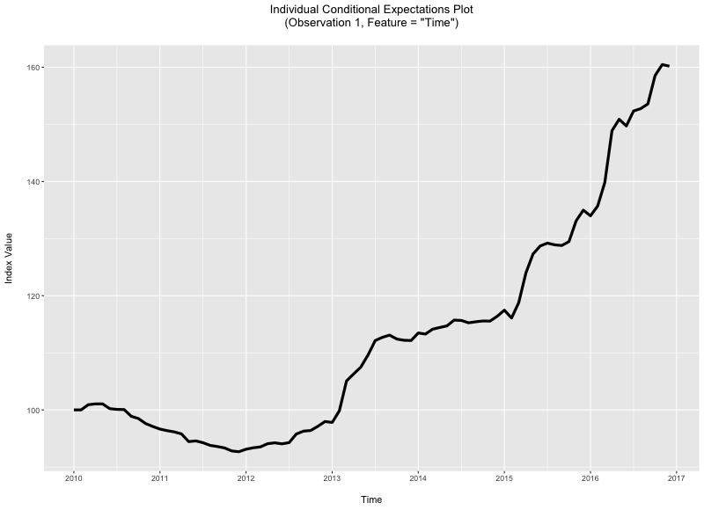
A Single ICE Example

Slide 8
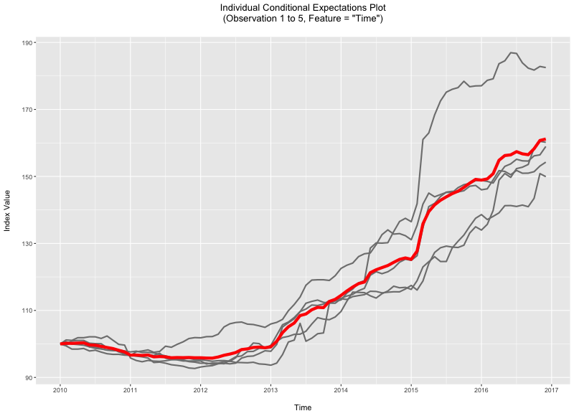
5 ICEs + Average

Slide 9
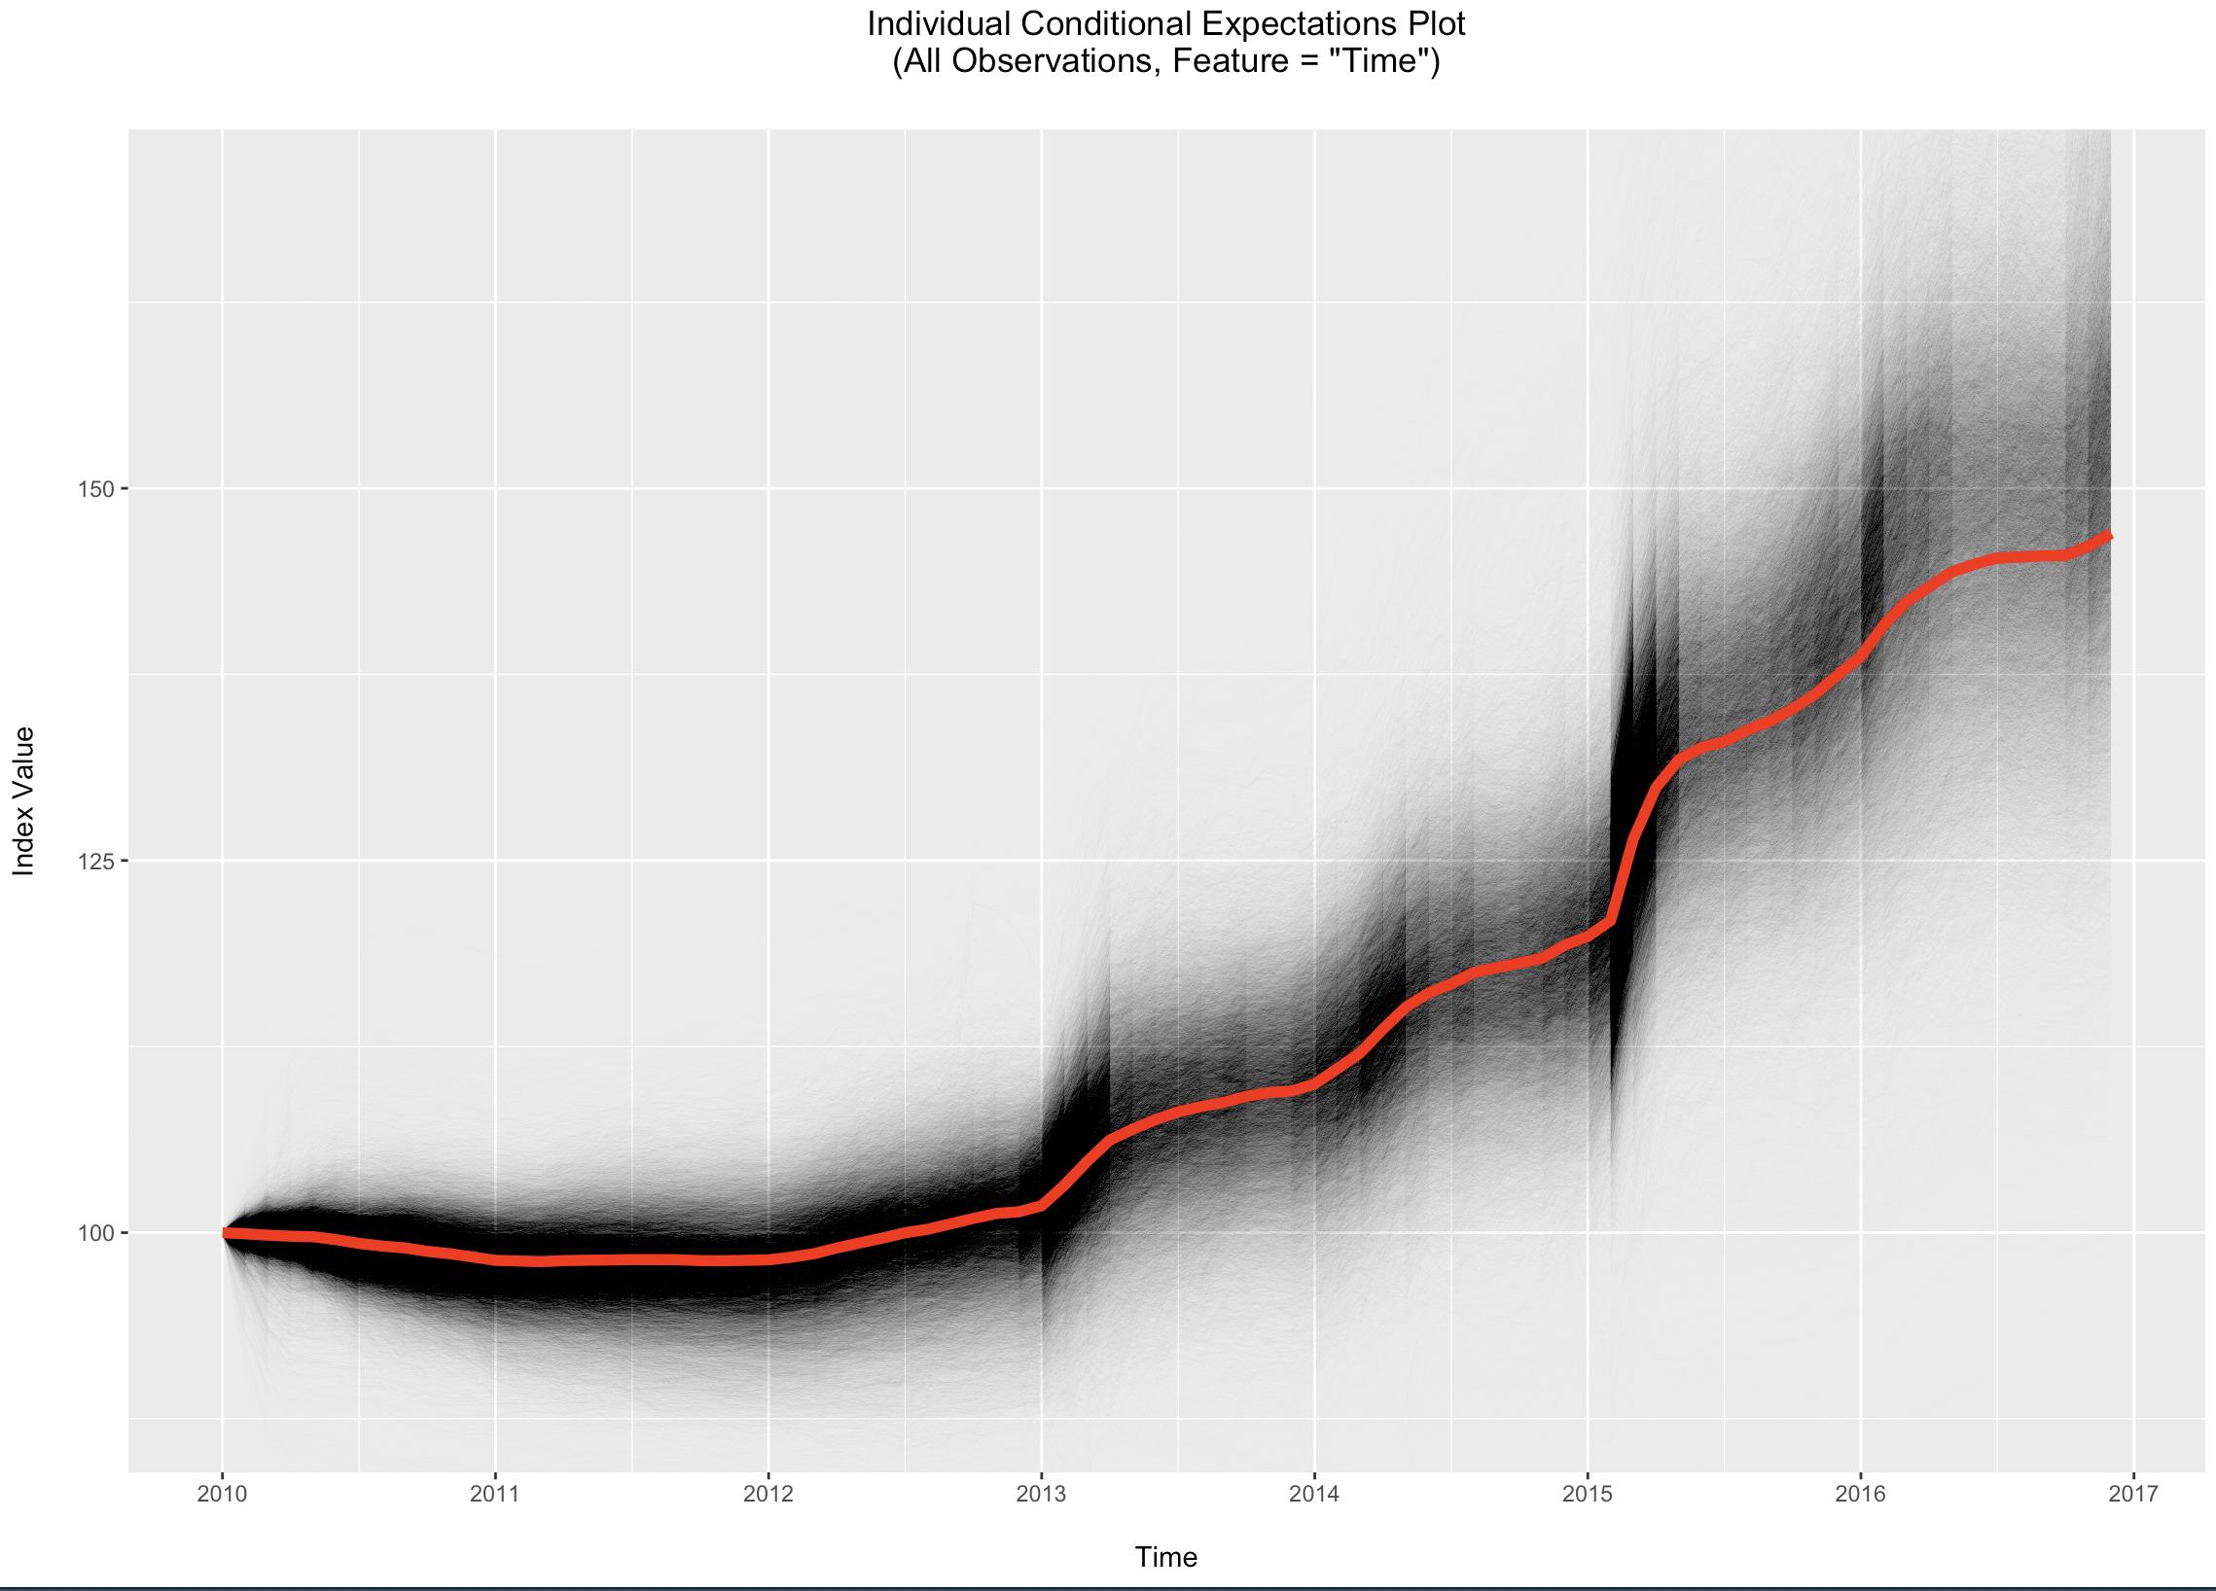
~43,000 ICEs -> PDP

Slide 10
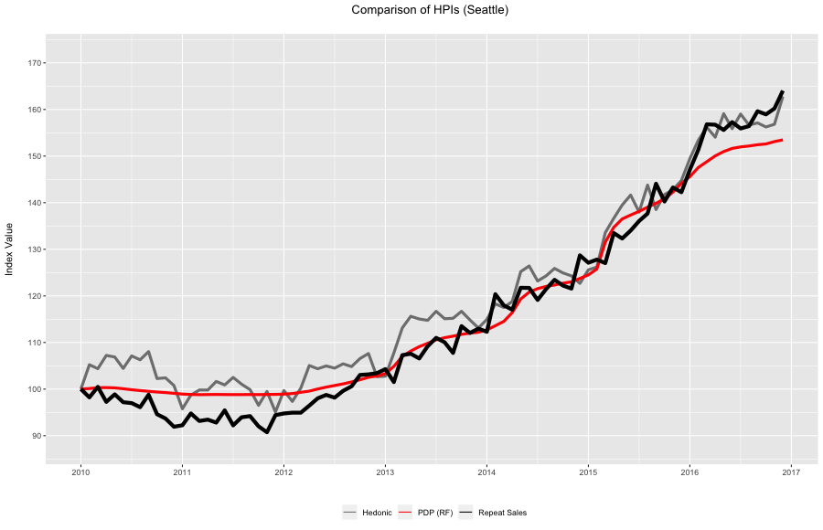
Comparison

Slide 11
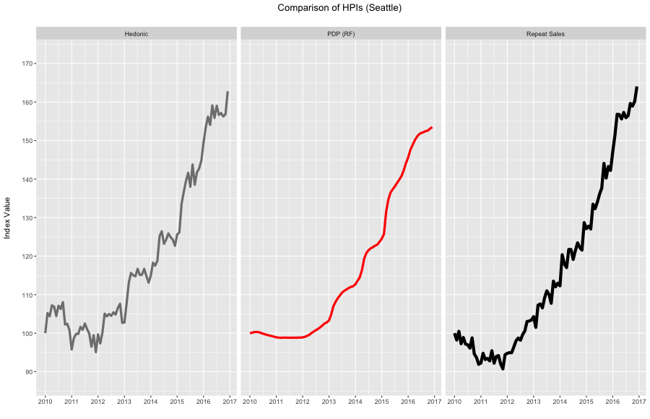
Comparison

Slide 12
Comparison to Existing Methods
Looks competitive (and certainly smoother), but is it better?
‘hpiR’ allows comparison by:
1) Volatility – Standard Deviation of three month moving average
2) Revision – Level of change in initial index values as index series grown over time
3) Accuracy – How well can we predict second transaction in a repeat sales pair?
In Sample – How well does it fit data?
Out of Sample – How well does it prediction in a K-Fold situation?
Future Prediction – How well does it predict at t+1?
`forecast` package, simple exponential smoothing

Slide 13
Comparison to Existing Methods
Compute index and series for full data set (~43k transactions, ~5k repeat)
Full 2010 through 2016 time period (84 months)
Robust RS and Hedonic Models
Method | Volatility | Revision | In Sample Accuracy | K-Fold Accuracy | Prediction Accuracy
Repeat Sales | .020 | .398 | .094 | .096 | .117
Hedonic | .021 | .010 | .095 | .097 | .095
RF – PDP | .001 | .062 | .093 | .093 | .100

Slide 14
Small Geographic Area Comparison
25 King County Assessment Zones
~ 2000 sales in each over the 7 year period
~ 250 repeat transactions in each
Method | Volatility | Revision | In Sample Accuracy | K-Fold Accuracy | Prediction Accuracy
Repeat Sales | .119 | .086 | .123 | .201 | .217
Hedonic | .061 | .013 | .101 | .105 | .099
RF – PDP | .002 | .077 | .093 | .095 | .110

Slide 15
Takeaways
Random Forest with Interpretability
Smoothest
Most accurate In and Out of sample
Intuitive explanation (value property X as if sold repeatedly)
Computationally expensive
Repeat Sales
High revision + worse accuracy
Faster + least data intensive
Hedonic model
Least Revision, Best Prediction accuracy
ML interpretability models offer some competitive performance
At the expense of compute time
Struggle at the ‘leading end’ of the index
Only tried one model type (RF) and one interpretability method (PDP)
‘hpiR’ offer quick way to test a model/method
Dataset, benchmark and a framework for comparison

